Slide 1
Installing Orbiter on Windows

Slide 2
Resources
Many of the steps will be taken from the following sources:
https://okunhardt.github.io/documents/Installing_WSL.pdf
https://docs.microsoft.com/en-us/windows/wsl/basic-commands
Consult the two links for further help and suggestions.

Slide 3
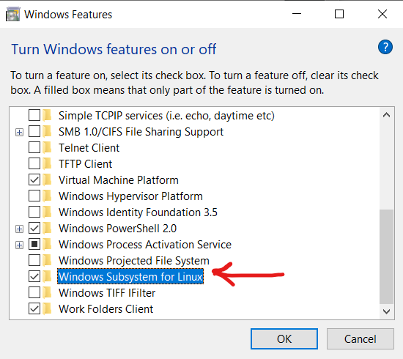
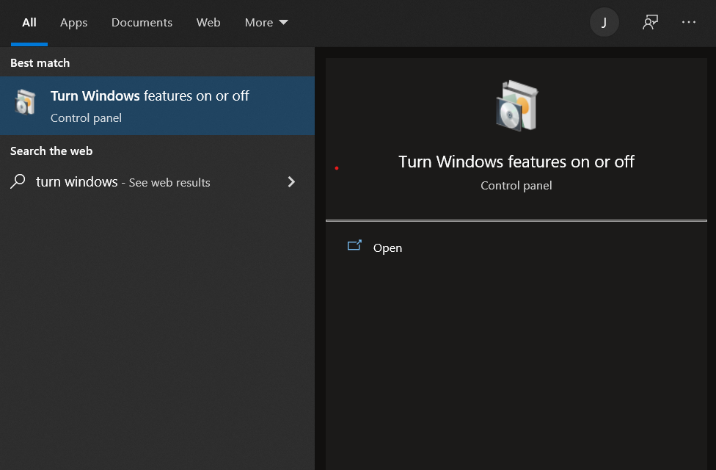
Installing WSL
Search “Turn Windows features on or off” in the Windows search bar
Search for “Windows Subsystem for Linux”, the box must be checked
Restart the computer

Slide 4
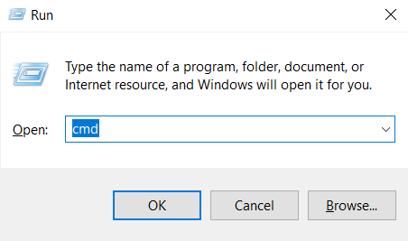
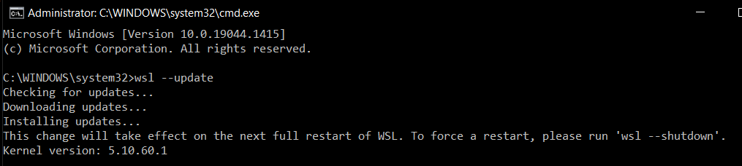
Update
The Windows Subsystem for Linux kernel does not automatically update due to system settings
Updates must be done manually
To update, first you need to command prompt as admin
Press Windows + R to open the “Run” box
Type “cmd” into the box
Press Ctrl + Shift + Enter
When the window prompt opens, click “Yes”
Command prompt will now open as admin
In command prompt
Type wsl --update
Type wsl --shutdown

Slide 5

WSL1, WSL2
When using WSL, you can adjust the configurations according to the Linux distribution that you are using
To run Ubuntu distribution, we need the WSL1 configuration
To check the status, in the command prompt enter
wsl --status
To change WSL configuration type
wsl --set-default-version 1
wsl --shutdown

Slide 6
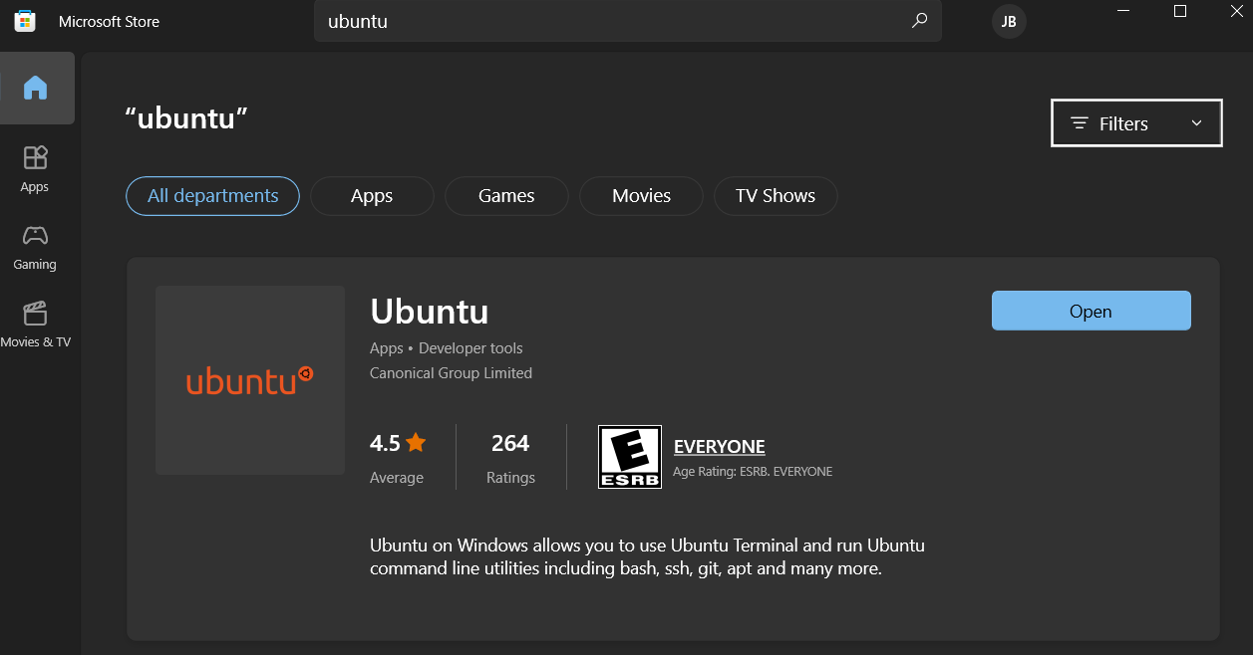
Ubuntu - installation
Generally, the Ubuntu distribution is installed by default when WSL is installed
wsl --status
Displays the default distribution
If you find that Ubuntu was not installed, you can find it in the Microsoft store
Launch Ubuntu after installation

Slide 7
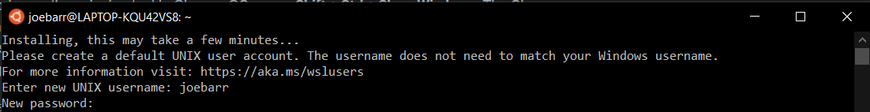
Ubuntu - launching
After launching Ubuntu, allow the installation to be initiated
If you receive an error, this could be a result of the configuration
Set configuration to WSL1
wsl --set-default-version 1
Make sure to terminate Ubuntu and reboot
wsl --terminate Ubuntu
Start Ubuntu again
Once Ubuntu starts correctly
Create Username & Password to complete installation
Note: the password will not appear when you type it

Slide 8
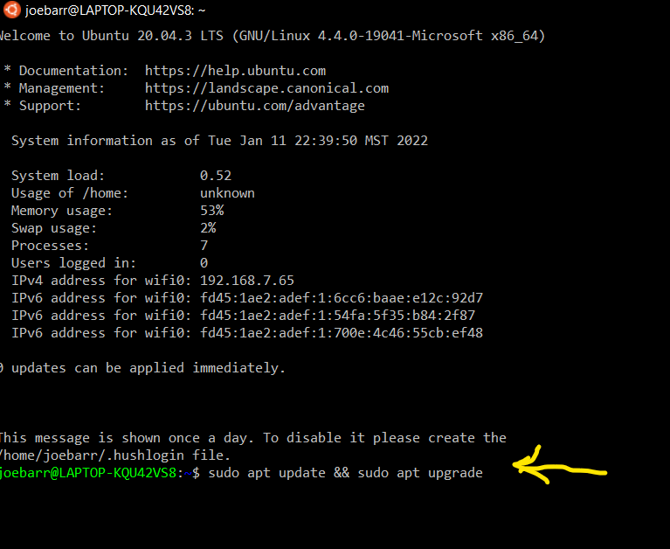
Ubuntu - update
Ubuntu does not update automatically, to update run the command
sudo apt update && sudo apt upgrade
You will be prompted to enter your password
When update are ready to be installed the message will appear
Do you want to continue? [Y/n]
Y + enter

Slide 9
Ubuntu – g++ and make
At this point, you have successfully installed and setup WSL, and now you can use the terminal as you would on Ubuntu
Terminate and reboot Ubuntu
Run the command in Ubuntu
sudo apt install g++
You can now compile C++ in WSL
Run the command in Ubuntu
sudo apt install make
You can now use makefiles in WSL

Slide 10
Orbiter - installation
The easiest way to run make is through the command prompt, not Ubuntu
To run WSL commands in command prompt, use either
wsl <command>
wsl.exe <command>
Open command prompt
Change directory to Users\username
cd C:\Users\”your username”

Slide 11
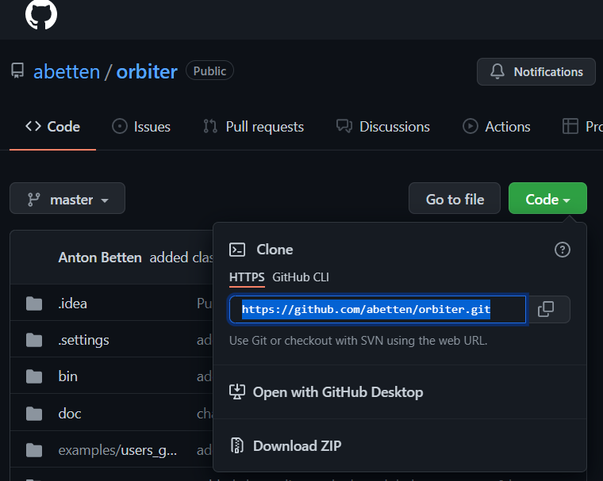
Orbiter - installation
In web, go to https://github.com/abetten/orbiter
Click on the green icon “Code” that opens a drop-down menu
You want to copy HTTPS URL

Slide 12
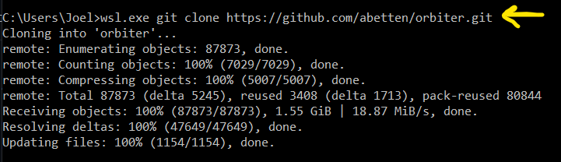
Orbiter - installation
In command prompt, once you are in C:\Users\Joel type the command
wsl.exe git clone https://github.com/abetten/orbiter.git
Hit enter
Now, orbiter will begin the cloning process

Slide 13
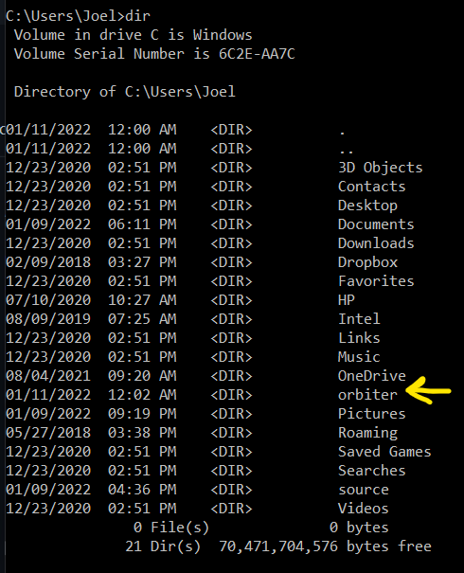
Orbiter - compile
After cloning orbiter, run the command
dir
You will find a new directory created called “orbiter”
Change directory to “orbiter”
cd orbiter

Slide 14
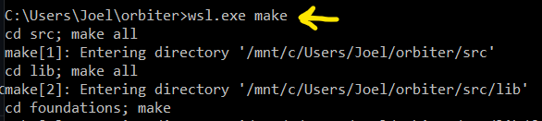
Orbiter - compile
Now that you are in C:\Users\”your username”\orbiter, run the command
wsl.exe make
The orbiter library will now be compiled, give it some time

Slide 15
Makefile
Now that orbiter has been successfully compiled, in the directory C:\Users\”your username”\orbiter
Change directory to C:\Users\”your username” and create a new directory
Ex: mkdir CPP_Workspace
Change directory into CPP_Workspace
cd CPP_Workspace
In C:\Users\”your username”\”new directory”, run the command
wsl.exe vim makefile
Vim (an IDE) will create the file “makefile”
For Vim commands, go to https://vim.rtorr.com/
Remember: all Ubuntu commands must begin with either
wsl or wsl.exe

Slide 16
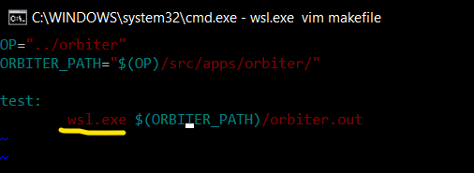
Makefile
To edit file in vim, click “i”
You will see --insert-- in the lower left-hand corner
The example to the right demonstrates a simple test to assure that orbiter is running correctly
Assuming that orbiter directory is located in C:\Users\”your username” then the variable OP and ORBITER_PATH should work just fine
Note were wsl.exe is inserted
Makefile contains Ubuntu commands not windows commands

Slide 17
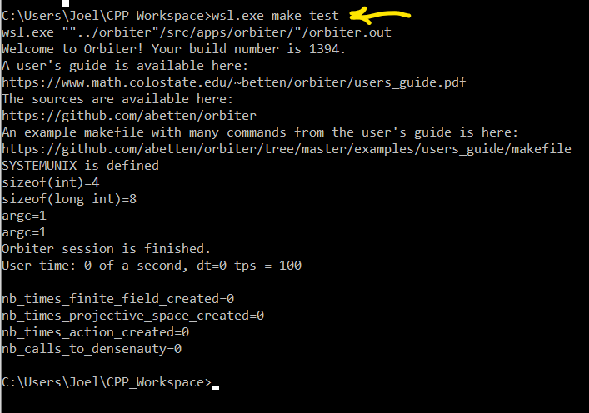
Running makefile
Now that you have created the makefile,
Click “esc” to finish editing in vim
Run the command
:wq + enter
This saves & closes the makefile in vim
You will be returned to
C:\Users\”your username”\”new directory”
In the directory run,
wsl.exe make test
Hit “enter”
If everything runs correctly, you will see

Slide 18
Orbiter - notes
Now that everything runs correctly, visit https://www.math.colostate.edu/~betten/orbiter/users_guide.pdf
This is the Orbiter User’s guide
Remember that you must use “wsl.exe make <target>” or “wsl make <target>” to run make correctly on linux distribution
Also, note how “wsl.exe” is used inside of the makefile
Ubuntu commands are used in makefile

Slide 19
Orbiter - update
To update orbiter, change directories to
C:\Users\”your username”\orbiter
Run the commands
wsl.exe make clean ; wsl.exe make
Good luck!

